Slide 1
Continents and Ocean Basins
The position of the continents and the ocean bodies, as we see in the map, have not been the same in the past. If this is so, the questions arises what were their positions in the past? Why and how they change their position?
Continents and ocean basins being fundamental relief features of the globe are considered as ‘relief feature of the first order’.
There are different views, concepts, hypothesis and theories regarding the origin of the continents and ocean basins have been put forth by the scientists from time to time.
Before examining these views about their origin we should know the characteristic features of the distributional patterns and arrangement of the continents and ocean basins as seen at present.
About 70.8 percent of the total surface area of the globe is represented by the oceans where remaining 29.2 percent is represented by the continents.

Slide 2
Some basic characteristic features of the distributional pattern of the continents and ocean basins
Even the distribution of different continents and oceans in both the hemisphere is not uniform.
There is overwhelming dominance of land areas in the northern hemisphere. More than 75 percent of the total land area of the globe is situated to the north of the equator.
Contrary to this water bodies dominate in the southern hemisphere.
Continents are arranged in roughly triangular shape. Most of the continents have their base in the north while their apices are pointed towards south.
Roughly, the oceans are also triangular in shape. Contrary to the continents the bases of oceans are in the south while their apices are in the north.
The north pole is surrounded by oceanic water while south pole is surrounded by land area.

Slide 3
There is antipodal arrangement of the continents and oceans. Only 44.6 per cent oceans are situated opposite to oceans and 1.4 percent of the total land area of the globe is opposite to land area.
More than 95 percent of the total land area is situated opposite to water bodies. There are only two case of exception to this general rule e.g. (1) Patagonia is situated opposite to a part of north China and (2) New Zealand is situated opposite to Portugal and Spain.
The great pacific ocean basin occupies almost one –third of the entire surface area of the globe.

Slide 4
Continental Drift Theory of Wegener
Aims of the Theory:-
Professor Alfred Wegener of Germany was primarily a meteorologist. He propounded his concept on continental drift in the year 1912 AD. But it could not come in light till 1922 AD when he elaborated his concept in a book entitled ‘Die Entstehung der Kontinente and Ozeane’ and his book was translated in English in 1924 AD.
Wegener’s displacement hypothesis was based on the works and findings of a host of scientist such as geologist, palaeo-climatologist, (Is the study of the past climate) palaeontologists(a person who studies very old dead animals or plant in fossils), geophysicists and others.

Slide 5
The main problem before Wegener, which needed explanation, was related to climate change.
Therefore the continental drift theory of Wegener ‘grew out of the need of explaining the major variations of climate in the past’.
Wegener explained the climate change occurred on the globe in two ways.
If the continents remained stationary at their places throughout geological history of the earth, the climatic zones might have shifted from one region to another region.
If the climatic zones remained stationary the land masses might have been displaced and drifted.
Wegener opted for second and rejected first. Thus, the main objective of Wegener behind his ‘displacement hypothesis’ was to explain the global climate changes.

Slide 6
Basic premise of the theory
Following Edward Suess, Wegener believed in three layers system of the earth e.g. sial, sima and nife.
According to Wegener sial was considered to be limited to the continental masses alone whereas the ocean crust was represented by upper part of sima.
Continents or sialic masses were floating on sima without any resistance offered by sima. He assumed, on the basis of evidence of palaeo-climatology, palaeo-ontology, botany, geology and geophysics.
He assumed that all the landmasses were united together in the form of one landmass, which named ‘Panagea’ in carboniferous period. There were several smaller inland seas scattered over the ‘Pangaea’ which was surrounded by a huge water body, which was named by Wegener as ‘Panthalasa’ representing pacific ocean.

Slide 7
According to Wegener all the continents formed a single continental mass, a mega ocean surrounded by the same.
The supper continents was named ‘Panagea’ which meant all earth.
The mega-ocean was called ‘Panthalassa’ meaning all water.
He argued that, around 200 million years ago, the super continent, ‘Pangaea’ began to split.
Pangaea first broke into two large continental masses as Laurasia and Godwanaland forming the northern and southern components respectively.
Subsequently, Laurasia and Godwanaland continued to break into various smaller continents that exist today.
Lauratia consisting of present North America, Europe and Asia formed northern part of the Pangaea while Godwanaland consisting of South America, Africa, Medagascar, ( now malagasy) peninsular India, Australia and Antarctica represented the southern part of the Pangaea.

Slide 8
Present location of continents and oceanic bodies

Slide 9
Evidences in support of the Theory
Wegener has successfully attempted to prove the unification of all landmasses on the basis of evidence gathered from geological, climate and floral records.
The following evidence support the concept of the existence of Pangaea during carboniferous period.
The matching of continents (Jig-saw-fit)
According to Wegener there is geographical similarity along both the coast of the Atlantic ocean. Both the opposing coast of the Atlantic can be fitted together in the same way as two cut off pieces of wood can be refitted ( Jig-saw-fit). Fig.5.3

Slide 10
Jig-saw-fit

Slide 11
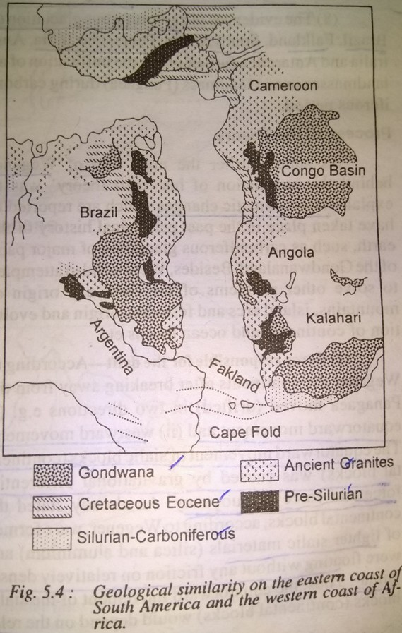
Geological based evidence
Geological evidence denotes that the Caledonian and Hercynian mountain systems of the western and eastern coastal areas of the Atlantic are are similar and identical (fig.5.4).
Geologically , both the coasts of the Atlantic are also identical.

Slide 12
Distribution of fossils
There is marked similarity in the fossils and vegetation remains found on the eastern coast of south America and the western coast of Africa.
It has been reported from geodetic evidences that Greenland is drifting westward at the rate of 20 cm per year.
The lemming (small sized animal) of the northern part of Scandinavia have a tendency to run westward when their population is enormously increased but they are founded in the sea water due to absence of any land beyond Norwagian coast.
This behaviour of lemmings proves the fact that the landmasses were united in the ancient times and animals migrate to far off places in the western direction.
The distribution of glossopteris flora in India, South Africa, Australia, Antarctica, Falkland island etc.
Placer deposit:-

Slide 13
Force responsible for the drift
According to Wegener the continents after breaking away from the Pangaea moved (drifted) in two direction (1) Equatorward movement and (2) westward movement. The equatorward movement of sialic block was caused by gravitational differential force and force of buoyancy.
The westward movement of the continents was caused by tidal force of the sun and the moon. According to Wegener the attractional force of the sun and moon, which was maximum when the moon was nearest to the earth, dragged the outer sialic crust (continental blocks) over the interior of the earth, toward the west.

